Slide 1
Swaps and Swaptions
Physics of Economic and Social Systems
MSc Physics of Complex Systems and Biophysics
Maximilian Ilg

Slide 2
Outline
MSc Physics of Complex Systems and Biophysics
Physics of Economic and Social Systems
Definitions: Swaps and Swaptions
Example
Preliminaries
Pricing European Swaptions
Summary

Slide 3




Definitions – Swaps
MSc Physics of Complex Systems and Biophysics
Physics of Economic and Social Systems
What is a Swap?
Contractual Agreement to Exchange Cash Flows
Receivables, Liabilities, even Debt or Equity
Same or Foreign Currency
Motivation: Financing, Interest Rate or Return Advantage
A Swap is a financial instrument for Trading Risk for Predictability

Slide 4
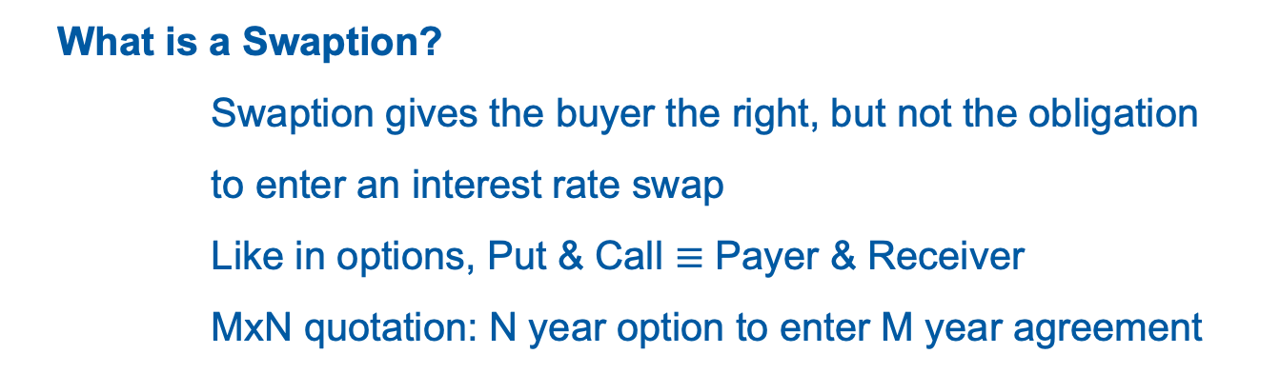
Definitions – Swaptions
MSc Physics of Complex Systems and Biophysics
Physics of Economic and Social Systems
What is a Swaption?
Swaption gives the buyer the right, but not the obligation to enter an interest rate swap
Like in options, Put & Call $≡$ Payer & Receiver
MxN quotation: N year option to enter M year agreement

Slide 5




Example
MSc Physics of Complex Systems and Biophysics
Physics of Economic and Social Systems
Interest Rate Swap
5%
Comp. A
Comp. B
EURIBOR + 1%
EURIBOR + 1%
5%
Swapping Risk for Predictability
Bank A
Bank B

Slide 6

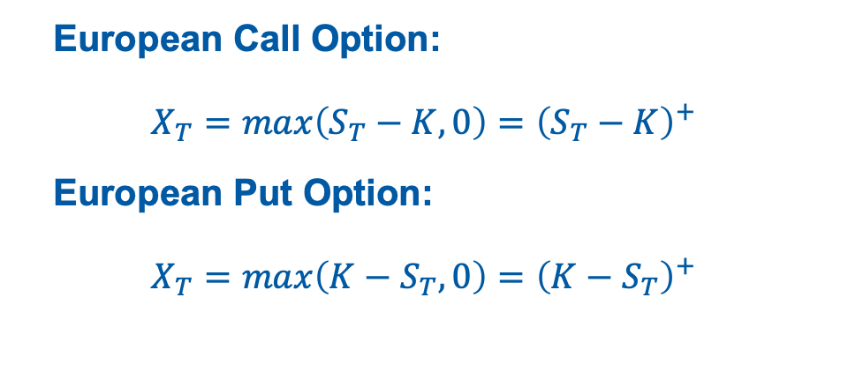
Preliminaries – Martingale Representation
MSc Physics of Complex Systems and Biophysics
Physics of Economic and Social Systems
European Call Option:
$$X_{T}=max\left(S_{T}−K,0\right)={\left(S_{T}−K\right)}^{+}$$
European Put Option:
$$X_{T}=max\left(K−S_{T},0\right)={\left(K−S_{T}\right)}^{+}$$
Price:
$$V_{t}=N_{T}𝔼^{ℚ_{N}}\left[ \frac{X_{T}}{N_{T}} | 𝓕_{t} \right]$$

Slide 7

Preliminaries – PV of a Swap
MSc Physics of Complex Systems and Biophysics
Physics of Economic and Social Systems
Net Present Value of an Interest Rate Swap:
$$PV^{Swap}=Φ\left[\sum_{i=1}^{n}{Nr^{Fixed}τ_{i}P\left(t,t_{i}\right)−\sum_{j=1}^{m}{N\left(l_{j−1}+s\right)τ_{j}P\left(t,t_{j}\right)}}\right]$$
Idea: Represent Float Leg as a Fixed Leg traded at Market Par Rate, $p^{Market}$

Slide 8

Preliminaries – PV of a Swap
MSc Physics of Complex Systems and Biophysics
Physics of Economic and Social Systems
Net Present Value of a Par Swap:
$$PV^{Par Swap}=Φ\left[\sum_{i=1}^{n}{Nr^{Fixed}τ_{i}P\left(t,t_{i}\right)−\sum_{j=1}^{m}{N\left(l_{j−1}+s\right)τ_{j}P\left(t,t_{j}\right)}}\right]=0$$
Par Rate:
$$r^{Fixed}=p^{Market}$$
$$PV^{Swap}=Φ\left[\left(r^{Fixed}−p^{Market}\right)A_{N}^{Fixed}−sA_{N}^{Float}\right], s≠0$$

Slide 9

Pricing European Swaptions
MSc Physics of Complex Systems and Biophysics
Physics of Economic and Social Systems
European Payer Swaption (Call Option Payoff):
$$X_{T}=A_{N}^{Fixed}max\left(p^{Market}−K,0\right)=A_{N}^{Fixed}{\left(p^{Market}−K\right)}^{+}$$
European Receiver Swaption (Put Option Payoff):
$X_{T}=A_{N}^{Fixed}max\left(K−p^{Market},0\right)=A_{N}^{Fixed}{\left(K−p^{Market}\right)}^{+}$
General Swaption Payoff:
$$X_{T}=A_{N}^{Fixed}{\left[Φ\left(p^{Market}−K\right)\right]}^{+}$$
$$Φ= ±1, Payer or Receiver$$
Notes:
In a receiver swaption the holder has the right to receive the fixed leg cashflows in the underlying swap at a strike rate agreed today and pay the float leg cashflows. A rational option holder will only exercise the option if the fixed leg cashflows to be received are larger than the float leg cashflows to be paid. Likewise a payer swaption extends the holder the right to receive the fixed cashflows from the underlying swap and has payoff XT

Slide 10

Pricing European Swaptions
MSc Physics of Complex Systems and Biophysics
Physics of Economic and Social Systems
Implementing the General Swaption Payoff $X_{t}$ into $V_{t}$:
$$V_{t}=N_{T}𝔼^{ℚ_{N}}\left[ \frac{X_{T}}{N_{T}} | 𝓕_{t} \right]$$
$$V_{t}=N_{T}𝔼^{ℚ_{N}}\left[ \frac{A_{N}^{Fixed}(T){\left[Φ\left(p^{Market}−K\right)\right]}^{+}}{N_{T}} | 𝓕_{t} \right]$$
Selecting the Annuity Measure $A_{N}^{Fixed}$ as numeraire, we get
$$V_{t}=A_{N}^{Fixed}(t)𝔼^{ℚ_{A}}\left[{\left[Φ\left(p^{Market}−K\right)\right]}^{+} | 𝓕_{t} \right]$$

Slide 11

Pricing European Swaptions
MSc Physics of Complex Systems and Biophysics
Physics of Economic and Social Systems
Using the Radon-Nikodym Derivative
$$\left(\frac{{dℚ}_{M}}{dℚ_{N}}\right)=\frac{\left(\frac{M_{t}}{M_{T}}\right)}{\left(\frac{N_{t}}{N_{T}}\right)}=\left(\frac{N_{T}}{N_{t}}\right)\left(\frac{M_{t}}{M_{T}}\right)$$
on $V_{t}$changes the Annuity Measure $ℚ_{A}$ to the risk-neutral Savings Account Measure, and leads to the generalized Black-Scholes Formula:
$$V{\left(T\right)}^{BS}=Φe^{−r\left(T−t\right)}\left[S_{t}e^{b\left(T−t\right)}N\left(Φd_{1}\right)−KN\left(Φd_{2}\right)\right]$$
Notes:
e−r(T −t) is the discount factor from time T to t under the savings account measure

Slide 12

Pricing European Swaptions
MSc Physics of Complex Systems and Biophysics
Physics of Economic and Social Systems
$$\text{For} \text{carry} b=0, \text{we} \text{get} \text{the} \text{Black}\text{-76 }\text{Formula}\text{:}$$
$$V{\left(T\right)}^{B76}=Φe^{−r\left(T−t\right)}\left[S_{t}N\left(Φd_{1}\right)−KN\left(Φd_{2}\right)\right]$$
European Swaptions without floating spread:
$$V{\left(T\right)}^{B76}=ΦA_{N}^{Fixed}\left(t\right)\left(p^{Market}N\left(Φd_{1}\right)−KN\left(Φd_{2}\right)\right)$$
$$d_{1}=\frac{ln\left(\frac{p^{Market}}{K}\right)+\frac{1}{2}σ^{2}\left(T−t\right)}{σ\sqrt{T−t}}$$
$$d_{2}=d_{1}−σ\sqrt{T−t}$$
scaled by the interest rate swap fixed leg annuity term $A_{N}^{Fixed}\left(t\right)$
Notes:
N here is the notional of an interest rate swap

Slide 13
Summary
MSc Physics of Complex Systems and Biophysics
Physics of Economic and Social Systems
A Swap is a financial instrument for Trading Risk for Predictability
A Swaption gives the buyer the right, but not the obligation to enter an interest rate swap
The formula for pricing swaptions is the Black-76 formula, scaled by the underlying swap annuity factor.

Slide 14
Thank you for your attention!
Maximilian Ilg

Slide 15
References
MSc Physics of Complex Systems and Biophysics
Physics of Economic and Social Systems
Montero, M. (2023) – Lecture Notes Physics of Economic and Social Systems
Burgess, N. (2018) – Interest Rate Swaptions - A Review & Derivation of Swaption Pricing Formulae
Burgess, N. (2015) – How to Price Swaps in your Head An Interest Rate Swap & Asset Swap Primer
Burgess, N. (2014) – Martingale Measures & Change of Measure Explained

Slide 16

Pricing European Swaptions
MSc Physics of Complex Systems and Biophysics
Physics of Economic and Social Systems
European Swaptions with floating spread:
$$V{\left(T\right)}^{B76}=ΦA_{N}^{Fixed}\left(t\right)\left(p^{Market}N\left(Φd_{1}\right)−K^{′}N\left(Φd_{2}\right)\right)$$
$$d_{1}=\frac{ln\left(\frac{p^{Market}}{K′}\right)+\frac{1}{2}σ^{2}\left(T−t\right)}{σ\sqrt{T−t}}$$
$$d_{2}=d_{1}−σ\sqrt{T−t}$$
$$K^{′}=K−s\left(\frac{A_{N}^{Float}\left(T\right)}{A_{N}^{Fixed}(t)}\right)$$
$$Φ= ±1, Payer or Receiver$$

